Slide 1
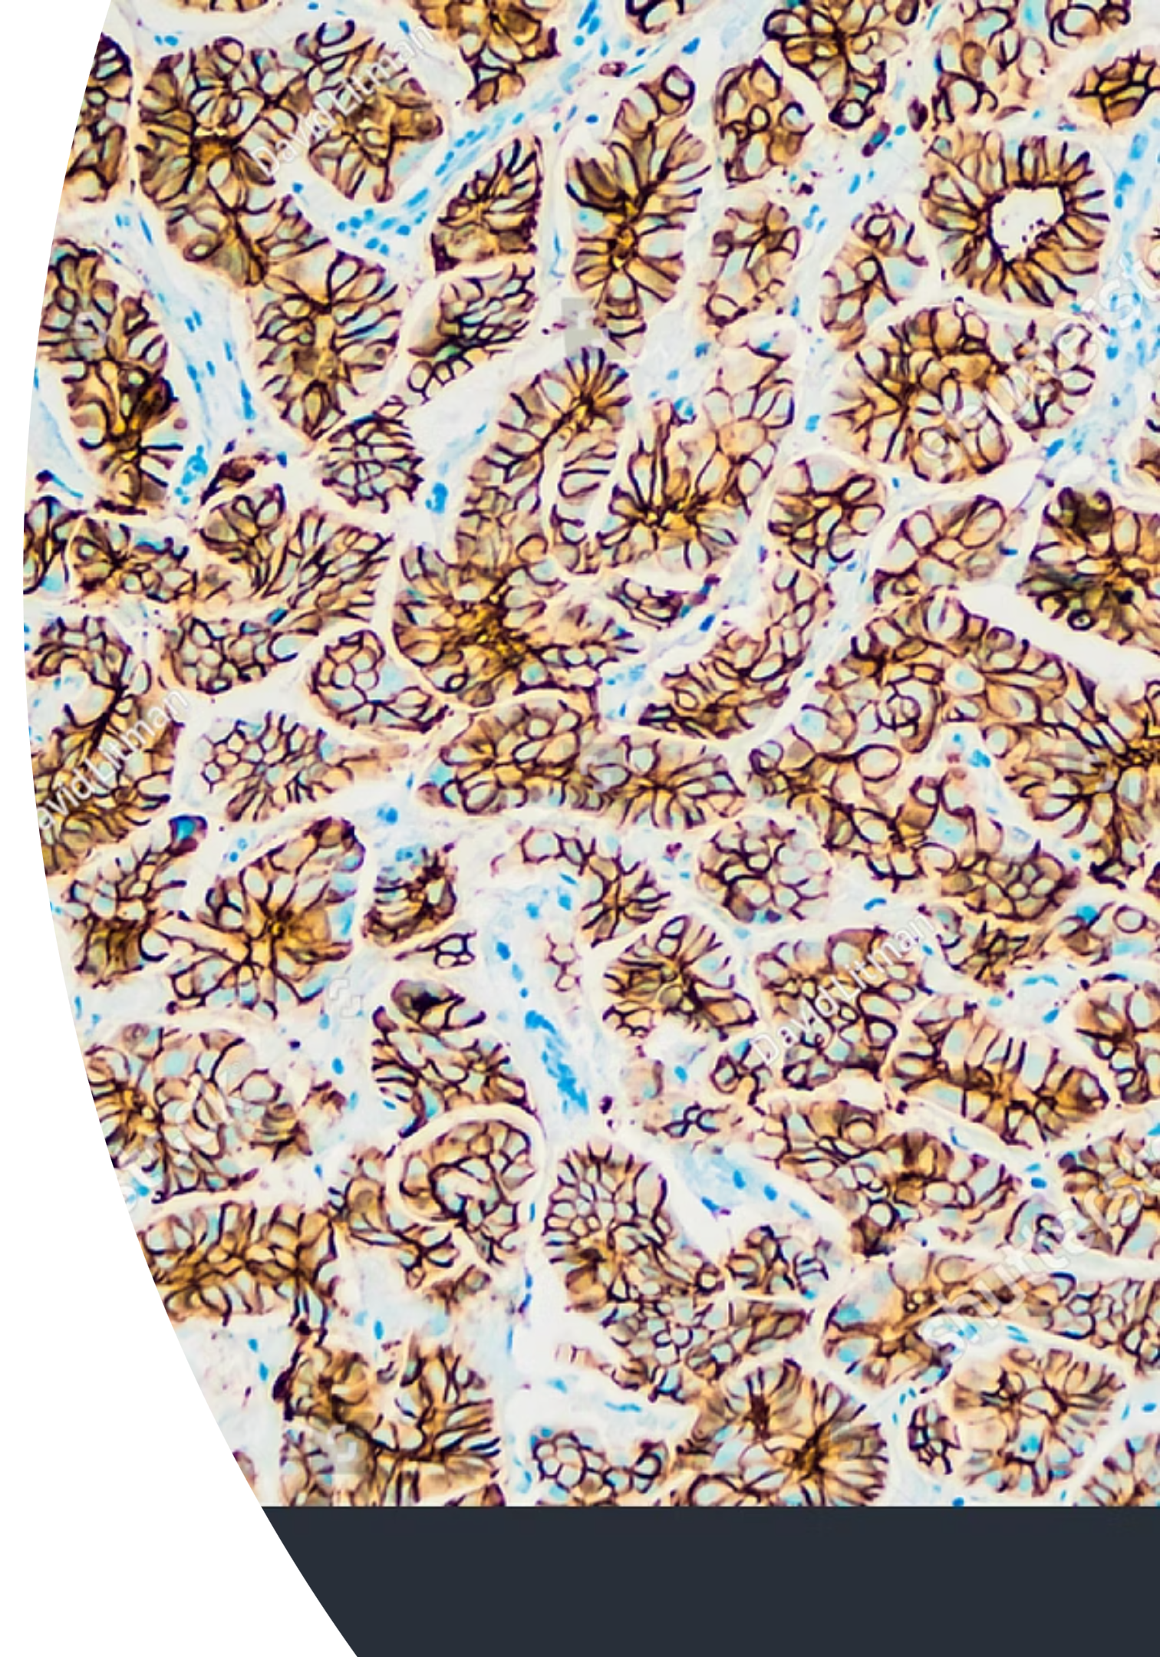
AI/ML for Breast Cancer Prediction: Improving Early Detection
Leveraging Artificial Intelligence and Machine Learning to enhance the accuracy and efficiency of breast cancer diagnosis.
-APPIKONDA NIKHILA SAI DEVI
322129512004

Slide 2

Agenda
01
02
03
The Critical Need
Our AI/ML Solution
Technical Approach
Understanding the challenge in current diagnostic practices.
How technology can provide consistent, reliable diagnostic support.
Exploring the features and methodology of our system.
04
05
Expected Impact
Team & Collaboration
The potential to transform patient outcomes and healthcare delivery.
Meet the researchers driving this innovation.

Slide 3
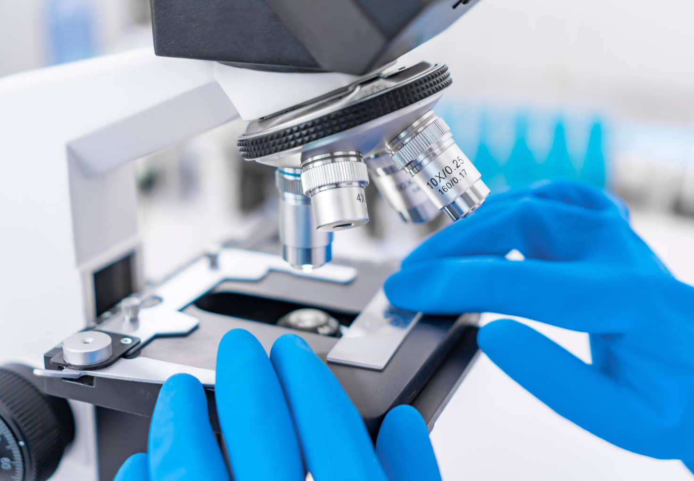
The Challenge: Subjectivity in Diagnosis
Breast cancer remains a leading cause of mortality among women globally. Early and accurate detection is paramount for successful treatment and improving survival rates.
Fine Needle Aspiration (FNA) cytology is a vital diagnostic tool. However, its interpretation by pathologists is often subjective and labor-intensive, leading to potential inconsistencies.

Slide 4
Limitations of Current Methods
Manual Interpretation
Time-Consuming Process
Risk of Error
FNA analysis heavily relies on individual pathologist expertise, leading to variability in diagnosis.
The manual review of slides is often slow, potentially delaying crucial treatment decisions for patients.
Human error, exacerbated by workload and fatigue, can result in misdiagnosis or delayed treatment.

Slide 5
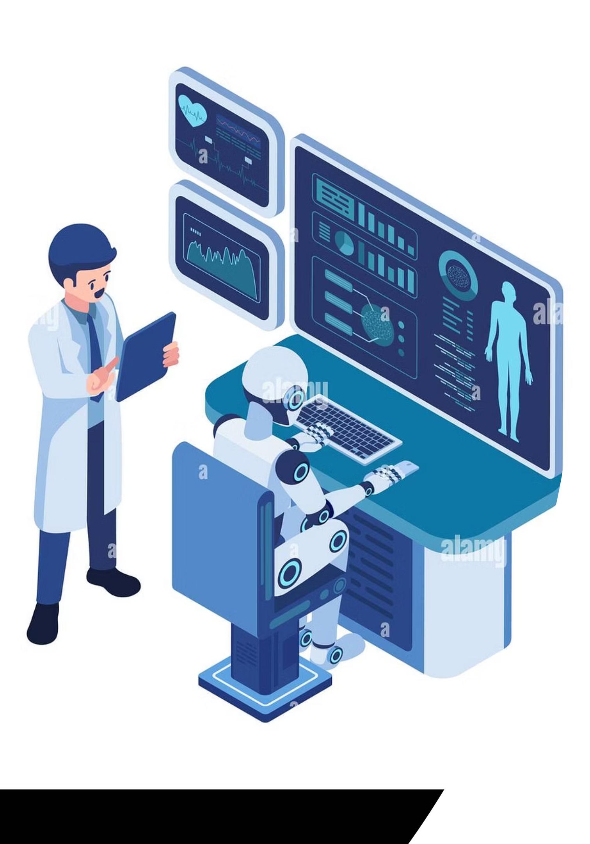
Our AI/ML Solution: A Diagnostic Aid
We propose an Artificial Intelligence and Machine Learning-based system to classify breast tumors. This system learns from complex medical datasets, offering consistent, fast, and reliable diagnostic support.

Slide 6
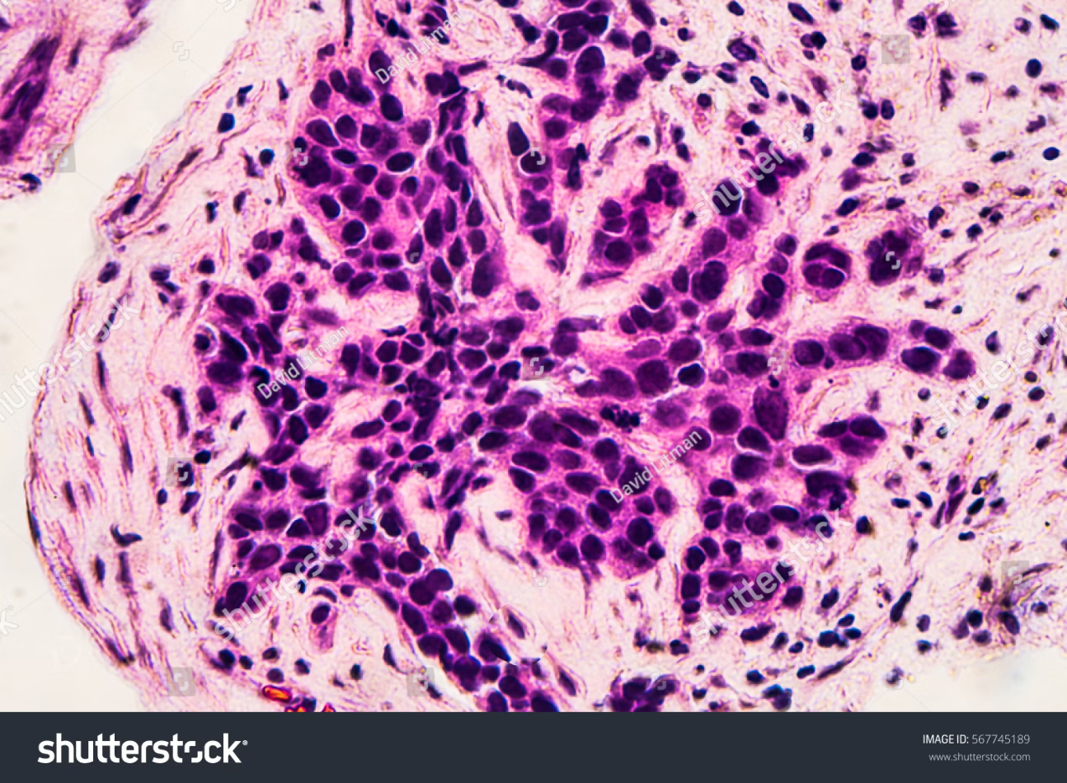
Technical Approach: Feature Extraction
Our system focuses on key cytological features from FNA samples to differentiate between benign and malignant tumors. These features are quantifiable and crucial for accurate classification.
Clump Thickness
Cell Shape Uniformity
Cell Size Uniformity
Mitosis
Marginal Adhesion

Slide 7
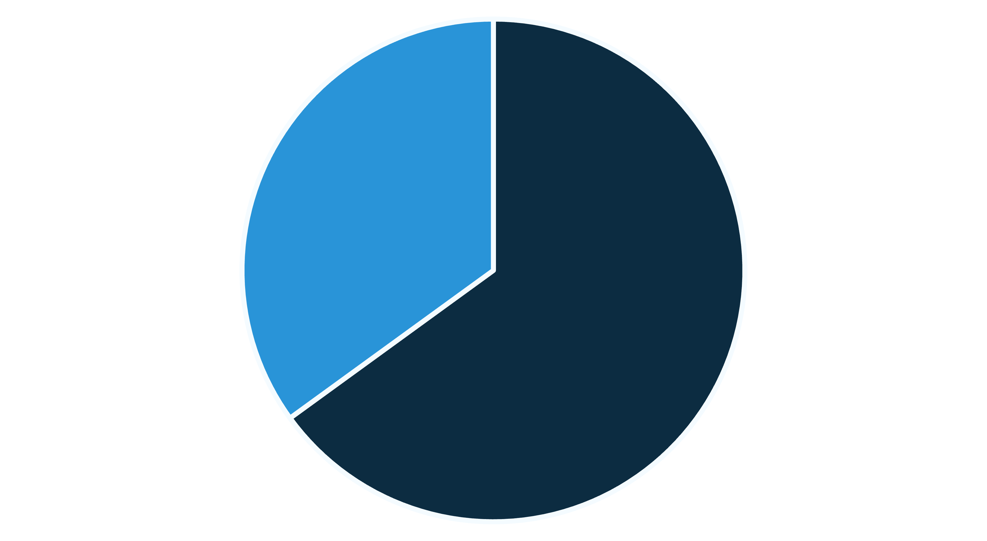
Machine Learning for Classification
The system employs advanced machine learning algorithms trained on a diverse dataset of FNA samples. These algorithms learn intricate patterns and correlations, enabling highly accurate tumor classification.
Benign (AI Predicted)
Malignant (AI Predicted)
This visualization demonstrates an example distribution of predicted tumor types, showcasing the system's classification capabilities.

Slide 8





Anticipated Impact on Healthcare
Enhanced Speed
Improved Accuracy
Significantly reduces diagnostic turnaround time, leading to quicker patient management.
Minimizes human error, offering more consistent and reliable diagnostic results.
Wider Accessibility
Better Patient Outcomes
Provides advanced diagnostic capabilities, particularly beneficial for resource-limited regions.
Supports earlier and more precise treatment decisions, ultimately saving lives.

Slide 9

Our Dedicated Research Team
This project is a collaborative effort, guided by our faculty mentor and driven by a passionate team of engineering students. Our diverse expertise ensures a comprehensive approach to this critical challenge.
"By blending AI/ML with medical diagnostics, we aim to empower healthcare professionals with tools that significantly improve patient care."

